Slide 1

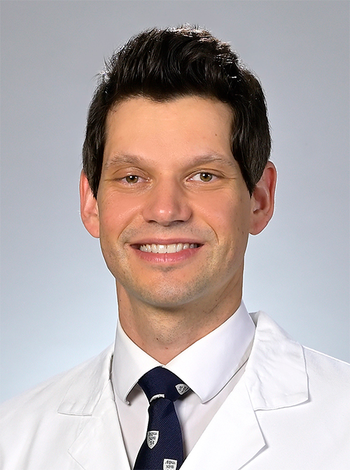






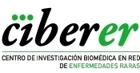
IDIBAPS and CIBEREHD organize the online seminar:
Immunotherapy targeting mutant KRAS
22nd November 2022
15.00h - 16.00h CET
Adham Bear MD, PhD
Penn Medicine
Abramson Cancer Center
University of Pennsylvania
Philadelphia, USA
https://www.pennmedicine.org/providers/profile/adham-bear
Zoom link
https://clinic.zoom.us/j/87511931868?pwd=WWtRSFVaVWZEbm1UQm1UWlJEV3lVdz09

