Slide 1

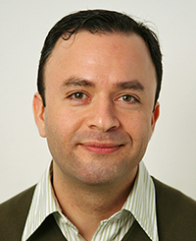








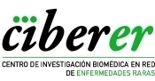
COST Action CA17118 TRANSCOLONCAN, IDIBAPS and CIBEREHD
organize the online seminar:
METABOLOMICS AND CANCER
18 May 2021
15.00h - 16.00h
Mazda Jenab
Nutritional Epidemiology Group
International Agency for Research on Cancer (IARC), Lyon, France
Zoom link
https://zoom.us/j/97255725827?pwd=dElNL3dWZXhPeVF2MG9lT0djUW80dz09
Meeting ID: 972 5572 5827
Passcode: 770265

