Slide 1
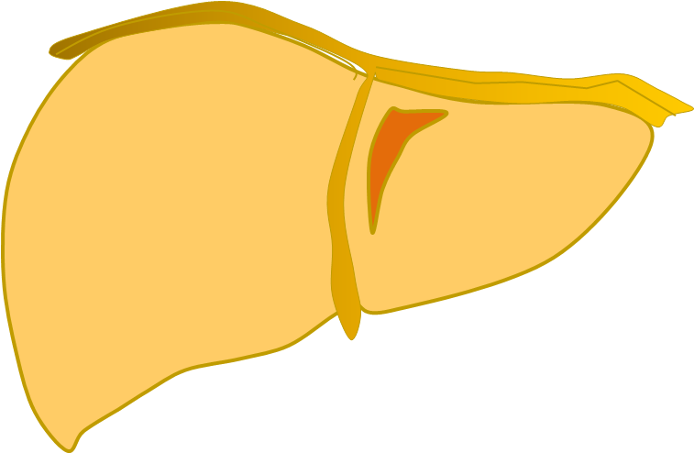
52nd Annual Scientific Meeting
“Precision medicine for healthy aging”
WORKSHOP 4
Hepato-Gastroenterology/Lipids
ORGANIZERS
Dr. Piero Portincasa (UNIBA, Bari, Italy)
Dr. Matías Ávila (UNAV, Pamplona, Spain)
Thursday 31st MAY - Friday 1st JUNE 2018
Hotel Barceló Sants, Barcelona (Spain)
Genetic regulation of liver metabolism
Quality of life in autoimmune liver disease
Circadian lipid metabolism and liver
Fatty liver disease in an aging population
Metabolic syndrome after cholecystectomy
Mitochondrial dysfunction and liver injury
Bile acids metabolism and disease
Mitochondrial adaptation in steatosis
Regulation of lipid metabolism in NAFLD
‘NAFLD’ in lean subjects

